Slide 1
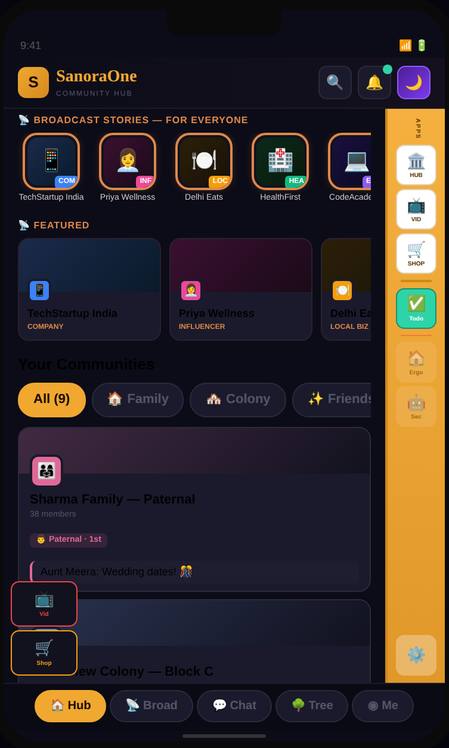
SEED ROUND · ROUND 2
SanoraOne
One login. Twenty-one doors. Six ready to launch.
One app. You sign in once. Inside are twenty-one smaller apps — for chatting, watching, shopping, planning your day, learning and sleeping better. You never sign in twice.
6
4
3
₹7cr
doors ready
engineers today
app stores live
raising
Sanora India Pvt Ltd · Confidential · Not for distribution
1
Notes:
Round 2. Corrections from Round 1: ad model restated honestly, team at 4, economics rebuilt on the real per-participant number.

Slide 2
THE PROBLEM
The phone is full. The user is exhausted.
80+
9 in 10
0
apps on the average phone
installs abandoned at signup
of them talk to each other
Each one a new account, a new password, a page of rules nobody reads.
Every new app makes you prove who you are, all over again, from scratch.
Your to-do list can't see your calendar. Your study app can't see what you buy.
Every app is its own island. None of them talk to each other.
Nobody planned it this way. Each app made sense on its own. But the person holding the phone pays for it — typing the same name, number and password again and again, on app after app.
2

Slide 3
THE IDEA
One universe. One login. Twenty-one doors.
SanoraOne is not twenty-one apps. It is one app with twenty-one doors. Whatever door you walk in through, that part opens first. Everything else is already inside — and you are already signed in.
1
2
3
4
You arrive
›
Sign in once
›
We show the right app
›
The rest is there too
From an ad, a link, a
QR code or an app store
Google, Apple or a
one-time code. Just once.
The app you came for
opens first
Free apps always on.
Everything else, one tap
The free part — always on, for everyone
In plain language
Chatting, watching and shopping are free forever. They are how people find us, why they stay, and the reason they keep coming back for years.
A hotel with twenty-one doors. Whichever one you enter, you land in a different first room — but your key opens every other room, and you never wait at the front desk again.
3

Slide 4
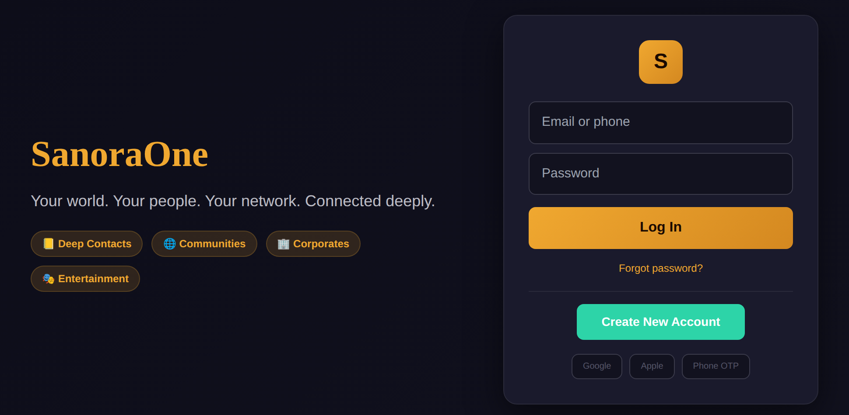
WHAT IT LOOKS LIKE
One sign-in, then never again
What loads next
The Moon
Top-right on every screen. Your tasks, your room, your assistant and your diary — one tap away from anywhere.
The door rail
Every other app sits on the right edge — the ones you own are lit up, the rest you can see but not yet open. Window shopping, on purpose.
Sign in one time — with Google, Apple, your phone number or email. After that you are never asked again, on any phone, laptop or door.
The free part
Chatting, watching and shopping sit underneath, free, on every single door.
Once = forever
One account across phone, web and computer. Twenty-one apps, one password, and no second sign-up screen ever again.
Screens are from the current build.
4

Slide 5
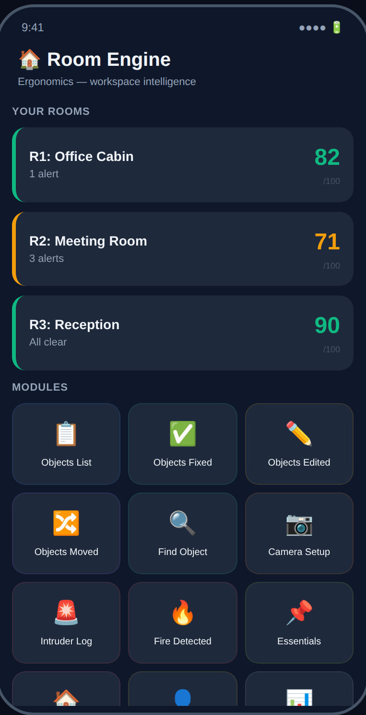
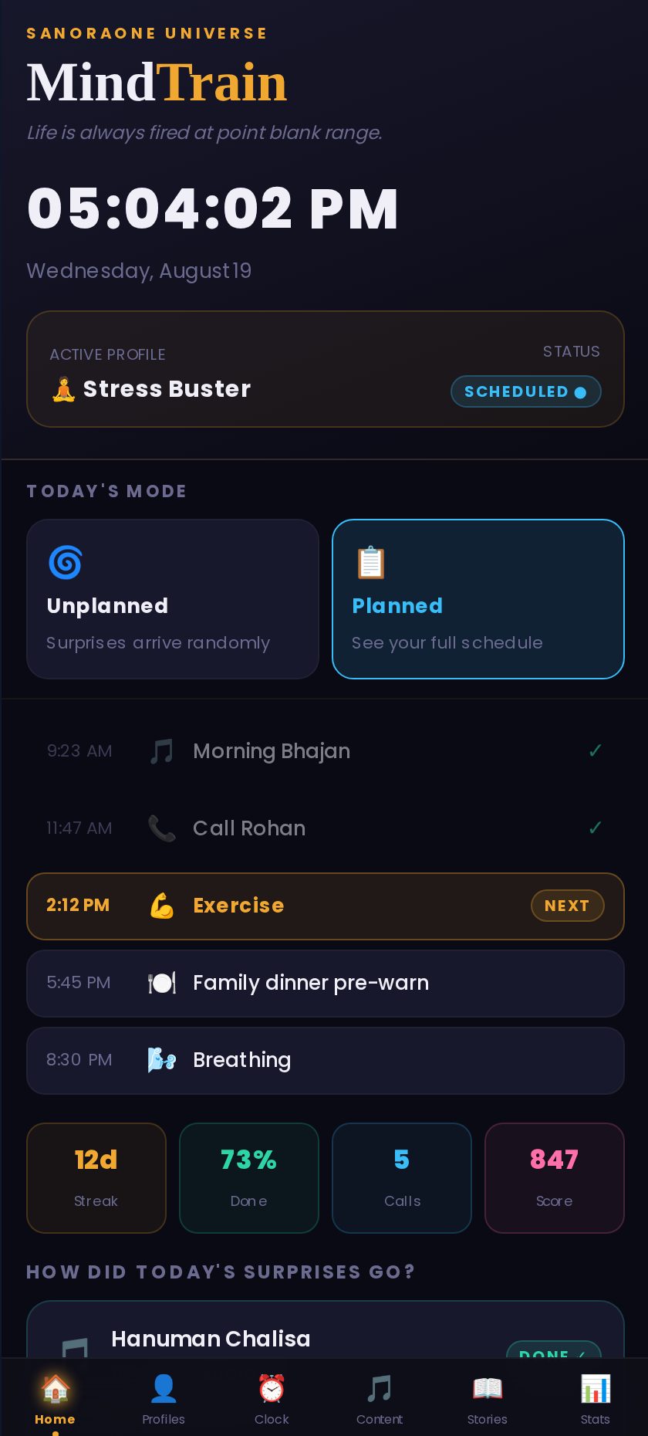
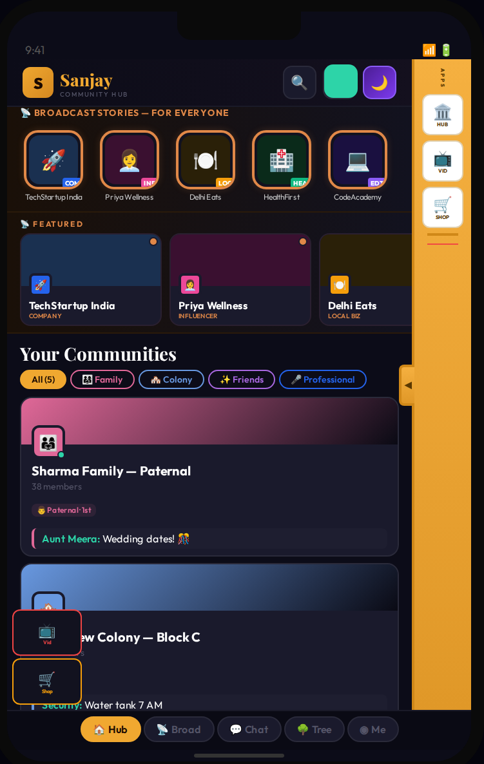
WHAT IS INSIDE
Six doors open on day one
Also built
— Todo + Assistant
— Learn & Earn
— Courses + AI Tutor
— Shopping
— Video / TV
— Money Scanner
— Messenger
— Languages
— Book Reader
— Camera Smarts
— Meetings
Room sensor
MindTrain
Social (free)
Watches each room — gives it a score,
flags what moved, broke, or who came in
Gentle alarms, sleep tracking,
and daily streaks in one place
Groups, updates and company pages
— free and always on
Every screen above uses the same sign-in, the same engine and the same store of data. Adding the next door is one screen and a little wiring — not a new company.
5

Slide 6
WHAT IS DONE
Six doors ready. Launch does not wait for the rest.
All twenty-one doors are fully planned and drawn up. That is not the same as being finished, and we will not pretend it is. Here is the real state today.
6
5
10
doors
doors
doors
LAUNCH-READY
IN BUILD — 50% TO 70%
PLANNED, WAITING
Done, tested and live. Social, Videos, Marketplace, Todo, MindTrain and Learn & Earn open in the first 15 days to a month.
More than half done. They arrive over months one to eight and add more income — they do not hold up the launch or the money.
Fully planned and drawn. Waiting on more hands to build them — which is what this money buys.
8
3
Filed
4
8 of 16
code projects
app stores live
patents filed
engineers, from 7
manuals written
Why six is enough to open with
The free part is among the six, and it is already live on Android, iOS and the Microsoft Store today. Every person the paid-to-join engine brings lands on a working app from day one. The unfinished doors add revenue when they arrive — they do not hold up the launch or the money, because year-one revenue does not depend on a single one of them.
6
Notes:
Never say twenty-one are built. Six ready, five at 50-70%, ten specified. The unfinished doors do not gate revenue — say that out loud.

Slide 7
WHY IT IS HARD TO COPY
Four choices that make us hard to copy
We can swap the AI brain without rebuilding the app
1
When a better AI comes out, we switch to it in minutes — no rebuild. Like a car built so the engine can be lifted out without cutting the car open. Most apps from 2024–25 got glued to one AI company. We didn't.
The Brain — one planner, many cheap helpers, one expert on call
2
One AI plans the job. Cheap AIs do the easy parts together. The costly AI is only called for the hard cases. This cuts our AI bill by about two-thirds.
We are the landlord, not the shopkeeper
3
We own the building. The licensed shops inside handle anything risky — money, medicines, legal work. So the legal risk sits with them, not us. We built it this way from day one, not after a court notice.
Nothing counts as done until we see proof
4
No task is 'done' until the machine shows the real result on screen. Every error is loud, never hidden. A running list tracks 51 loose ends, and nothing is ever quietly deleted. This way of working is rarer than the product itself.
7

Slide 8
ABOUT ADS
Ads sit beside your content. Never in your way.
Yes, we show ads — the way Facebook and Google do, sitting next to what you came for. What we will never do is put an ad in your way, blocking the thing you opened the app to use.
What we do
What we refuse
Ads on the free version
No ad gates, ever
Google ads are already live on the free web version. Shops can also pay for a better spot in the marketplace to show their own products.
We will never say 'watch this ad to continue'. If a feature only opens after an ad, we have not built it. This rule never bends.
Ads users can ignore
Paid apps have no ads
Ads sit beside the content. The page works and you reach what you wanted, whether you ever look at the ad or not.
The moment you pay for a door, the ads leave it. Paying should buy quiet, not a smaller ad.
Ad money keeps the free part free
No ad-tracking of children
Chatting, watching and shopping stay free for everyone, because the ad money covers part of the running cost.
Users aged 13–17 only see general ads, never ads based on their habits — locked in the app, ahead of both Google's rules and India's data law.
We say this plainly because anyone can check it: open our code and you will find live Google ads. The difference is not that we have no ads — it is that an ad never stands between you and your own app.
8
Notes:
Say this before they ask. Google ads are live on the web and any investor can see it. Better they hear it from you than find it later.

Slide 9
HOW WE GET USERS
We do not hunt for users. They enrol, and they pay.
This is the whole plan, and it is why the numbers on the next pages work. Every other app spends money to find people. We charge a fee to join — so finding users is not a cost at all. It is our income.
EVERYONE ELSE
SANORAONE
Spend to find a user
They enrol, and they pay ₹2,000
Pay to be seen, hope for a download, pray they stay. ₹300–800 out of your pocket for every person who ever pays you anything.
The person arrives already paying — and brings their family, friends and supporters onto the free app behind them, costing us nothing.
THE PAID-TO-JOIN ENGINE
FREE APPS + WORD OF MOUTH
APP STORES + SEARCH
~60%
of year-one users
~25%
of year-one users
~15%
of year-one users
Our own paid-to-join programme. Exactly what it is, how it works, the pricing and the sharing trick are kept secret and shared only after a secrecy agreement is signed.
Chatting, watching and shopping are free and genuinely useful. That is what turns a one-time visitor into someone who stays.
Twenty-one doors means twenty-one places people can find us in app stores and search — each for a different need. One app, many chances to be found.
The paid-to-join engine is the heart of this business, so it is kept off these slides on purpose. We explain it fully only after a signed secrecy agreement.
9

Slide 10
THE GOAL
2,00,000 paying people in twelve months
How the number is assembled
Joined through our ground and online push
1,20,000
Joined because a member told them
50,000
Found us in app stores and search
30,000
Year-one target
2,00,000
Every one of these two lakh people pays ₹2,000. The free users they bring with them — family, friends, voters — are a separate, much bigger crowd that we have NOT counted here or in any money number. We checked ten lakh in our own working; two lakh is the safe figure we will stand behind. That is about 16,700 a month, most of them later in the year.
This is a plan, not a promise. The workings are open to see, and our accountant checks them before anyone acts on them.
10
Notes:
If pressed on the ten lakh figure: yes we modelled it, and we are not asking anyone to fund a plan that needs it.

Slide 11
THE MONEY
₹2,000 in. ₹1,767 of it is ours.
What one person is worth to us
Fixed cost, year one
Joining fee (GST added on top, paid to govt)
₹2,000
Ground and online joining drive
₹2.0 cr
Team — four today, three hires
₹1.4 cr
Card / UPI fee, ~2%
–₹47
Servers and the free apps
₹0.6 cr
Video, storage, playback, AI scoring, ID check
–₹61
Legal, accounts, rules, patents
₹0.4 cr
Support, disputes, refunds
–₹25
Total fixed
₹4.4 cr
Winners' pool — a set 5% of what we collect
–₹100
The ₹2.0 crore drive is not a guess — our own rule sets it: we never spend ₹1 unless we expect ₹20 back.
What we keep per person
₹1,767
~25,000
people to break even
₹4.4cr of fixed cost ÷ ₹1,767 we keep each. Test us on this number.
Winners are bought out, not given a cut. One or two per event sell us their work for a set sum, paid from a pool we declare as a share of what we collect — never a fixed prize promised before anyone has paid. We usually spend less than the 5% we set aside.
₹23 cr
profit after tax at 2 lakh
₹35.3cr kept, less ₹4.4cr cost, minus 25% tax.
Every line can be checked. The ₹61 machine cost holds only if entries are 60 seconds, low resolution, and views are capped — all locked before launch. The card fee is 2% of the full amount collected. GST (the sales tax) is added on top of the ₹2,000 and passed to the government. Numbers to be checked by our accountant.
11
Notes:
Lead with 25,000, not with 23 crore. The break-even is what a serious investor tests.

Slide 12
EXTRA MONEY, NOT COUNTED
None of this money is counted yet.
The ₹40 crore of first-year money comes from the paid-to-join engine alone. Every income line below is real and built — and we left every one of them OUT of our number, because we would rather beat a small number than explain a big one.
App subscriptions
The book
Marketplace
Single doors and value bundles, each priced on its own, with an all-in bundle cheaper than buying the parts. Two lakh people already inside is the pool this sells to.
A book launch riding the same reach the paid-to-join engine already pays for. Extra cost to reach those people: zero.
Shops pay a listing fee based on how many products they add, plus extra to promote their own items. We never take a cut of the sale — which keeps us out of the risky legal seat.
Learn & Earn for business
Ads on the free version
Sixteen more doors
Companies pay to place products inside short lessons, and pay for grouped, no-names market research. Business income that pays for free learning for the user.
Google ads on the free web version, already running. Tiny per person, but real across a crowd this big.
Courses and AI tutor, MindTrain, room sensor, money scanner, video, language learning and the rest. Each one an income line we have not put in any number shown to you.
All twenty-one doors share one sign-in, one engine and one store of data. That is why the next income line costs one screen and a little wiring — not a new company, a new team, or a new round of funding.
12

Slide 13
HOW WE SET THE NUMBER
Five AIs. Fifteen days. Told to break the plan.
The ₹2,000 fee and the two-lakh target are not the founder being hopeful. They came out of fifteen days of hard brainstorming with five separate top AI systems, each told to attack the plan and find its holes, not to agree.
THE VERDICT
₹2,000 per person is the right price, and two lakh people in the first year is easily reachable.
It works because people pay to join instead of us paying to chase them. That one flip removes the cost that kills most apps — and it survived every attack the five AIs threw at it.
1
2
3
4
Five, kept apart
Told to attack
One no re-opens it
Founder decides
Five different AIs answer on their own. None sees another's answer before giving its own.
Each one is told to find the fault, not the good. Just agreeing, with no objection, is not accepted.
If even one AI disagrees, that point is looked at again on its own. A majority vote does not settle it.
The AIs only advise; they never act. Every decision is signed off by a person and written into a numbered log.
What it changed: the cost sheet was rebuilt three times. Video cost had been guessed 20–40 times too high, AI judging 4–15 times too high, ID checks about 50 times too high. Fixing those dropped break-even from 57,000 people to 25,000. The same five AIs also watch the app inner workings — three failed tries at any problem, and all five are called in to find the cause.
13

Slide 14
WHAT CAN GO WRONG
The three biggest risks — we say them first
Participants who do not recruit
HIGHEST
The plan assumes each paying person brings others in. If that spreading does not happen, growth stops at whatever we paid for. This is the risk that decides the company — so we only spend more once we have measured a real 20-times return, not before.
Social platform blocking
HIGH
Big platforms can slow or block our sharing at any time, with no warning. We planned for it from day one: many web addresses, different ad designs, our own list of everyone who joined, and people on the ground who don't depend on any one platform being nice to us.
Rules in other countries
MEDIUM
Paid-to-join events have different rules in every country. We start in India, prove the number, then grow country by country — with real income paying for the legal work, not a promise.
Also tracked
The sales-tax rate (GST), handling foreign money, and checking content when there is a huge amount of it. All three are being worked on now with proper advisers — none of them holds up the launch.
We would rather you hear these from us in the first meeting than find them in the third.
14

Slide 15
THE PLAN, MONTH BY MONTH
Fifteen days to a month to launch. Building either way.
DAY 0–30
MONTH 1–3
MONTH 4–8
MONTH 9–12
Public launch
First cycle
Ramp or hold
Scale
Six doors go live — the free part is already on all three app stores. The door-picker is finished. The paid-to-join engine is ready. The public home page is live.
The paid-to-join engine runs its first round. The free part soaks up the crowd it brings. 25,000 people — below break-even, on purpose.
We spend more on the ground only if the 20x rule is met. Room-sensor screens, the AI course tutor, video series playback. 1,30,000 people.
Twenty-one doors grow to thirty-five. Servers that grow themselves. A second country. 2,00,000 people and the first full-year profit.
Why the round is not a gate
We are ready to launch inside fifteen days to a month, and we build every day whether this closes or not. The money does not start the company — it decides how fast the paid-to-join engine runs, in how many cities, and whether twenty-one doors become thirty-five in twelve months or in thirty. You are buying speed, not survival.
15

Slide 16
THE TEAM
Four today, down from seven — and shipping faster
The current four
Dr Sanjay
Founder & CEO · Designs it all
Raghav
Zeeshan
Builds front and back, puts it live
Phone apps
A working dentist who ran a dental group of about ₹4 crore a year, stepped away for twelve months, and designed this whole platform end to end — all twenty-one apps, the door logic, the brain, the legal set-up and the manuals — without writing the code himself.
He sets the design and makes the calls. The AI writes the code. The engineers connect it up. That is why the team went from seven to four and the output went up, not down.
Vansh
Drishti Arora
AI parts and testing
Head of PR
Why four is not a weakness
The AI writes the code from a written plan, and we check it against real on-screen proof. Engineers connect it. The number of people is no longer what limits us — how fast we join things up is.
What the round hires
A senior engineer to clear the join-up backlog, one phone-app engineer, a growth lead to run the paid-to-join engine on the ground, and a legal adviser kept on call across the licensed partners.
16

Slide 17
WHERE YOUR MONEY GOES
Where your money goes, and when it comes back
In one line: the money is not for building. The building is done and paid for. It buys reach — people on the ground and screens in front of people before the first round runs.
1
Months 0–4
2
Month 4
3
Months 5–12
4
Year 2 onward
Money goes out
The gate
The engine funds itself
Profit, or a sale
₹2 crore on the ground-and-online joining drive, plus the team. Nothing comes back yet. This is the risky window — and it is the only one.
We measure what the ground spend returns. Below 20x we do not push harder — we stop, fix, and test again. That rule is written down, not just a hope.
Past about 25,000 people, each new one adds ₹1,767 on top of costs we have already covered. Growth stops needing your money.
At the target, profit after tax is around ₹23 crore — before a single rupee from the other sixteen doors. You get paid as a dividend, by selling your share, or under Option A as cash back from monthly sales.
The honest downside
If people who join do not bring others who also join, we stop at whatever we paid for, and the money is gone. Not half — gone. There is no version of this without that risk. What we can promise: you will know inside four months, not four years, because we measure it and you see the number either way.
17
Notes:
Say the downside out loud. Founders who lead with it get better terms than founders who are cornered into it.

Slide 18
WHAT WE ARE ASKING FOR
₹7 crore. Two ways to invest. Your pick.
OPTION A
OPTION B
7% share + money back
15% share, nothing else
You own 7% of the company, forever.
Company valued at ₹40 crore before your money, ₹47 crore after.
Your ₹7 crore paid back at 1.5–2x, as a small slice of monthly sales.
₹7 crore buys 14.9% of the company — clean, with no pay-back.
Pay-back only starts after we make ₹10 crore profit — nothing owed before that.
You get regular updates and a seat to watch board meetings.
For someone who wants their money back, and keeps a share of the upside too.
For someone who wants the biggest share of the upside, and nothing else.
Use of funds
29%
30%
25%
16%
Ground & online joining drive
New team members
Servers & AI
Legal, rules, patents
The ₹40 crore price is set against what it would cost to rebuild all this, the patents filed, and an income engine bringing in about ₹40 crore in year one — from one door alone. These are opening terms; both sides take proper legal and money advice before signing.
18
Notes:
₹40cr reconciles the ₹20cr private number and the ₹55cr earlier deck. Do not quote all three in the same season.

Slide 19
The three-year view
A place people never have
to log into twice.
Twenty-one doors grow to thirty-five. India grows to India plus Indians abroad plus the Gulf. The free part stays free, and ads stay where they belong — beside the content, never in front of the person.
21 → 35
2 lakh → 20 lakh
1 → 4
doors
participants
markets
Sanora India Pvt Ltd · sanoraone.com
Confidential — launch engine mechanics under NDA only
19

